Slide 1
What’s Going on in the World of DNS
Current Topics in the DNS Operations Community
David Huberman
ICANN’s Office of the CTO
DD Month 2017

Slide 2
Topics
Applications Doing DNS
Public DNS & Resolver Centrality
DNS as an Attack Vector
Update on the KSK Rollover

Slide 3
Applications Doing DNS

Slide 4
DNS Resolution’s Traditional Model
Recursive resolvers are typically run by the service provider:
The ISP
The University
The Company
And when the service provider controls the recursive, many of the needs of the service provider are met. For example:
Regulatory compliance
Searches for certain key words that the government requires be logged and/or not responded to
Malware Protection
Service providers know to block access to certain sites that seek to harm the end users

Slide 5
It Works in Public DNS, too!
Increasingly, recursive resolvers are operated by public DNS providers:
Google: 8.8.8.8
Cloudflare: 1.1.1.1
TWNIC: 101.101.101.101
… and many, many others
The same goals can still be met:
Regulatory compliance
Governments serve legal process on public DNS operators to respect their local laws
Malware Protection
Some public DNS providers (like Quad9: 9.9.9.9) block access to bad sites as part of their value proposition

Slide 6
But These Resolution Models have Security Concerns
“The DNS is one of the most significant leaks of data about an individual’s activity on the Internet.” – Sara Dickinson, Sinodun
DNS queries are sent in cleartext (UDP or TCP) which means anyone doing passive monitoring of our DNS learns everything we are asking
Queries contain the domain names being asked about, but also contain metadata about domains for things like the chat services we are using and the domains of our email contacts
Some VPNs don't include the resolvers the user might have chosen, and in that case the DNS traffic will be exposed in unencrypted channels
DNS responses from the recursive to the stub are the most vulnerable to being censored or re-written

Slide 7
One Solution is to Encrypt
Encryption provides assurances:
Queries cannot be surveilled
Eliminates man-in-the-middle attacks
In 2017 and 2018, the IETF standardized two encryption technologies for DNS:
DNS-over-TLS (DoT)
DNS-over-HTTP (DoH)

Slide 8
DNS-over-TLS (DoT)
DoT (RFC 7858) takes advantage of Transport Layer Security (TLS) to encrypt DNS traffic between the stub resolver and the recursive resolver, giving users authentication and confidentiality for their DNS queries
Runs on TCP/853 instead on UDP/53 (making it easy to discover and filter)
Useable by any application taking advantage of TLS
Email
Mobile apps

Slide 9
DNS-over-HTTPS (DoH)
Protocol Goals (RFC 8484)
Who do you trust?
“I trust my bank to give them my money.”
“I trust my bank enough to do online banking with them.”
“Maybe my bank is the most trusted vendor I should use for recursive resolver service.”
The user decides who she trusts the most with her DNS traffic, and she configures the DoH application to use a trusted DoH resolver
Runs on TCP/443 and is co-mingled with web traffic in a single HTTPS connection, making it much harder to discover and filter

Slide 10
But This New Model Prompts Some Concerns
Service providers have a new paradigm to negotiate:
No longer able to rely only on DNS to meet regulatory compliance and filtering goals
What happens if it does not work?
The user configures her web browser to use a DoH resolver. For whatever reason, DNS resolution stops working properly. A major concern for service providers is that the user now calls them and asks for help.
ISPs do significant business working with parents on parental controls. When applications do their own DNS, a lot of these parental controls no longer work.
ISPs often receive court orders to block certain sites. DoH/DoT resolvers do not know about these court orders, and still resolve these sites.

Slide 11
Taking a Further Step Back: Policy Concerns
Stepping back from the service provider concerns, ADD introduces all new challenges for broader public policy:
Which laws apply?
In the traditional model, the recursive resolver providing the answers to the end user device is generally found in the same country as the user. Applications doing their own DNS will often mean that the recursive resolver is in a different country, which means a different legal jurisdiction.
Very important when you think about complex topics like content filtering laws and end user data privacy regulations

Slide 12
Taking a Further Step Back: Policy Concerns
Stepping back from the service provider concerns, ADD introduces all new challenges for broader public policy:
Who gets to determine the resolver?
The DoH protocol was designed to allow the end user to decide who they trust most for recursive DNS service. But nothing stops the application maker from deciding for the user what resolver will be used.
What if the application maker is not honest and is purposely using a resolver which steers queries away from their intended sites and instead, provides DNS answers to sites that the application maker can profit from?
What if the resolver operator is monetizing DNS data without the user’s consent?
Bad or dishonest implementations of ADD disempower end users, and do so in a context that most end users know nothing about: recursive DNS resolution

Slide 13
Taking a Further Step Back: Policy Concerns
Stepping back from the service provider concerns, ADD introduces all new challenges for broader public policy:
Where do we discuss these broad public policy issues?
ICANN?
CENTR?
Network operator forums?
IETF?
CAB Forum?
Regulators?
The answer is probably all of the above. Through community consultation and collaboration we can identify issues and find resolutions.

Slide 14
Parting Thoughts on Applications Doing DNS
Applications doing their own DNS with DoH is new, but ADD in general is already being implemented in web browsers and mobile applications
DNS privacy – especially end user DNS data privacy – is a major regulatory and societal concern
Encrypting DNS data with TLS or HTTPS is good for addressing privacy concerns
But implementation details matter, and there are a lot of public policy concerns for how ADD could be implemented in a way that has negative effects for end users, for service providers, and for regulators

Slide 15
Public DNS & Resolver Centrality

Slide 16
Public DNS
APNIC recently conducted some measurements into resolver centrality
They asked: “How many recursive resolver operators does it take to cover 50% of Internet users?”
Their answer was: “About 8 or 9”
Google Public DNS (8.8.8.8) answered about 33% of the queries
Other big global resolvers included China Unicom, China Mobile, DNSpai, Comcast, and OpenDNS (Cisco Umbrella)

Slide 17
Centrality at ORG
The CTO of PIR recently publicly stated:
“Two dozen resolver systems are responsible for some 80% of all traffic seen at ORG servers, today. Somewhere between 15 and 20% of all end-user systems use Google Public DNS for resolution.”

Slide 18
The Centrality Dilemma
The popularity of public DNS can be a good thing for a lot of network operators. But we have to keep in mind that centrality of recursive resolvers could mean that a relatively small number of organizations could make decisions that affect a lot of people.
e.g., supporting or not supporting a particular DNS protocol enhancement or a feature
DNSSEC might be a good example: Google DNS is responsible for a huge amount of DNSSEC validation happening.
”Over-centralized” recursive service prompts numerous concerns about the content being resolved:
What if a central resolver operator decides to do content filtering?
A nation-state with authority over a central resolver operator might exert control
Twitter, Facebook, and other mass media have tried in the past to implement automated content filtering. Arguably, that hasn’t worked so well. Now think about doing that at the DNS level, and you’re affecting a lot of people!
Or what if an operator decides to augment the namespace by adding their own TLD?

Slide 19
Centrality and Privacy
If data privacy is the goal of efforts like DoH and DoT, then perhaps we should be worried that a large percentage of query traffic is resolved by the most popular recursive resolver providers
Some of the most popular public DNS resolvers are homed in countries where there are either weak data privacy laws, or there are laws that allow the home government to demand query data from the providers

Slide 20
DNS as an Attack Vector

Slide 21
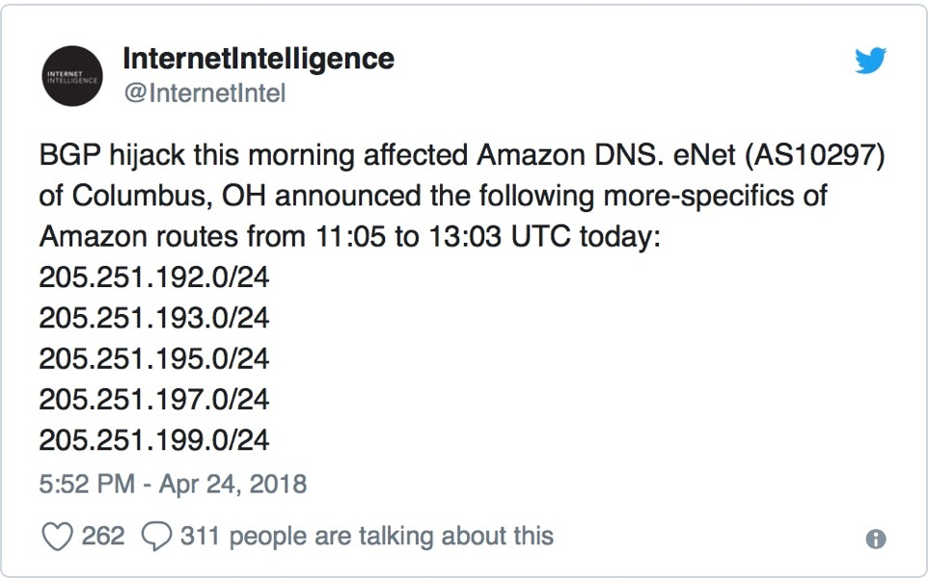
MyEtherWallet.com
Route hijacking of AWS auth DNS addresses to re-direct user queries to a name server the criminals control
NS now gives out IP address to a fake MyEtherWallet.com website
Users input login credentials into the fake site
Attackers steal ~USD21,000,000 of cryptocurrency from the real MyEtherWallet.com using the harvested login credentials
Notes:
The MyEtherWallet.com incident in April 2018 was a prime example of attacking infrastructure services like routing and DNS to re-direct users to a web site masquerading as MyEtherWallet.com. Once users entered their login credentials into the fake website, the attackers were able to use those login credentials on the real site and siphon cryptocurrency.

Slide 22
DNSpionage & Sea Turtle
“Military cyber-offense prepositioning” – gathering the intelligence needed to launch military cyber attacks
Apparently targeting ~40 organizations in 13 countries in North Africa and the Middle East
Apparently targeting:
National security organizations
Ministries of foreign affairs
Energy companies
Notes:
Sometimes the motivation for a cyberattack is political or involves the military. DNSpionage and Sea Turtle are two similar incidents that gather up troves of data from compromised system, all for “military cyber-offense prepositioning” – pre-positioning for future attacks.

Slide 23
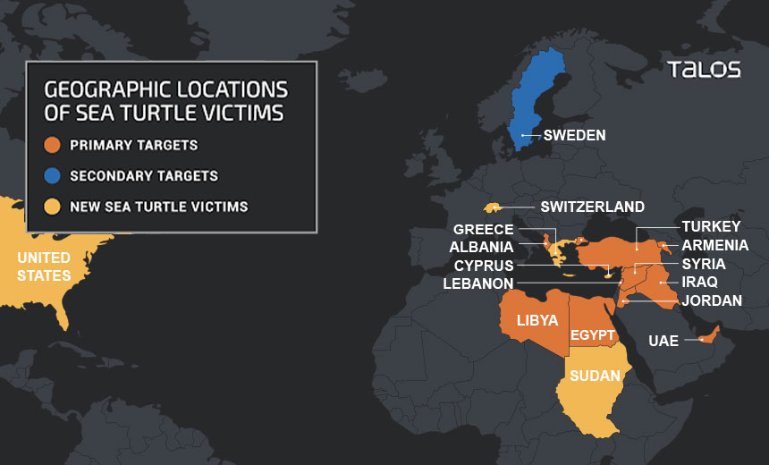
Cisco Talos’s View of Sea Turtle

Slide 24
Methodologies
10-minute attacks to avoid detection
Compromised EPP credentials
Re-write authoritative NS
Obtain easy-to-get certs from Let’s Encrypt or Comodo
Keep harvesting data to build credentials repository
Re-write IMAP info
Capture email credentials
Capture email, calendaring, vcards

Slide 25
Improvements
RPKI
Consider making IMAP accessible only from within a trusted LAN
Registry Lock
DNSSEC as a path to DANE

Slide 26
Update on the KSK Roll

Slide 27
The KSK Rollover
11 October 2018 ICANN changed the KSK
The multi-year process to get to 11 October taught us that we don’t fully understand the effects of rolling the KSK
We saw evidence a small number of operators experienced downtime. But they’re not participating in DNS technical community forums, so we don’t know why they went down.
DNSKEY queries greatly increased until KSK-2010 was removed from the root zone
Next steps:
The IANA owns the decision making on this and will propose a strategy for public comment in the near future. Some considerations include:
Roll it yearly? 2 years? 5 years?
Oh and by the way, at some point in the future we need to consider rolling the algorithm used to compute the key signatures

Slide 28
Engage with ICANN – Thank You and Questions

